Slide 1
Deep SLAM
Progress report @ Su Lab, 2020/02/12
Presenter: You-Yi Jau, M.S. in UCSD

Slide 2
Outlines
Deep Keypoint-based Camera Pose Estimation with Geometric Constraints
Progress: Path to deep SLAM

Slide 3
Deep Keypoint-based Camera Pose Estimation with Geometric Constraints
You-Yi Jau, Rui Zhu, Hao Su, Manmohan Chandraker
CVPR 2020 Submission

Slide 4
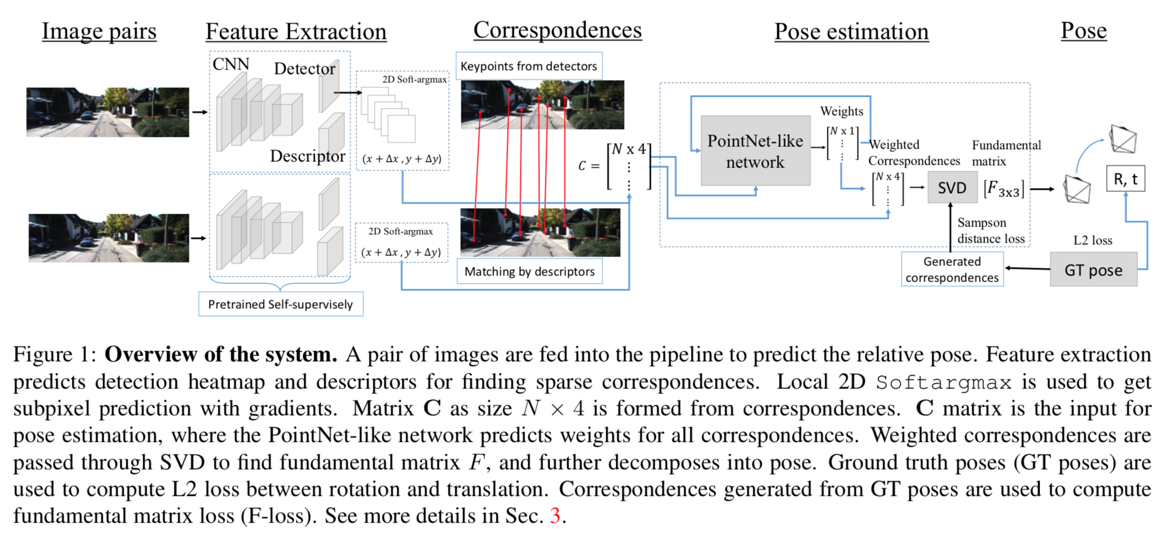
Camera pose estimation
Black box

Slide 5
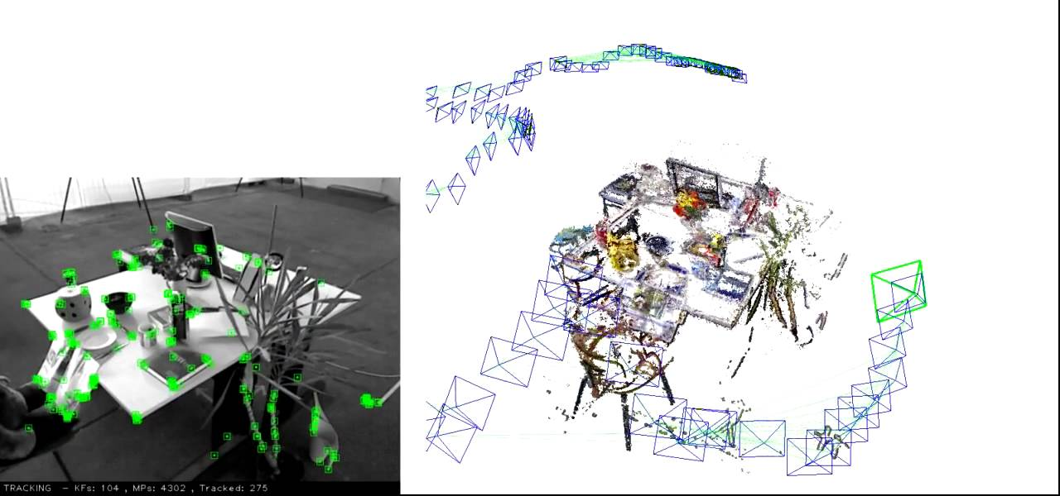
Example: ORB-SLAM
Image → ORB feature extractor (green points) → correspondences
Correspondences → Camera pose (R, t) → Trajectory

Slide 6
Motivation and problem description
Camera pose estimation has been the key to Simultaneous Localization and Mapping (SLAM) systems
SIFT + RANSAC method has dominated the design of camera pose estimation pipeline for decades.
Basic challenges for learning-based systems.
Not trained and optimized end-to-end for the ultimate purpose of camera poses
The over-fitting nature of training-based methods
Existing learning-based keypoint detector is weaker than SIFT

Slide 7
Contribution
A new end-to-end trainable framework for feature extraction, matching, outlier rejection, and relative pose estimation
The pipeline is tightly connected with the novel Soft-argmax bridge, and optimized with geometry-based objective obtained from correspondences
The thorough study on cross-dataset setting is done to evaluate generalization ability, which is critical but not much discussed in the existing works

Slide 8
Prior works
Geometry-based visual odometry
ORB-SLAM: 8-point algorithm, PnP, RANSAC, bundle adjustment
LSD-SLAM
Learning-based visual odometry
CNN-SLAM: depth prediction, PoseNet
DeepVO: RNN
Learning-based feature extraction and matching
SuperPoint, … (many new papers)
Learning-based camera pose estimation
Sfm-learner
Deep fundemental matrix estimation (DeepF)

Slide 9
Overview: Pipeline

Slide 10
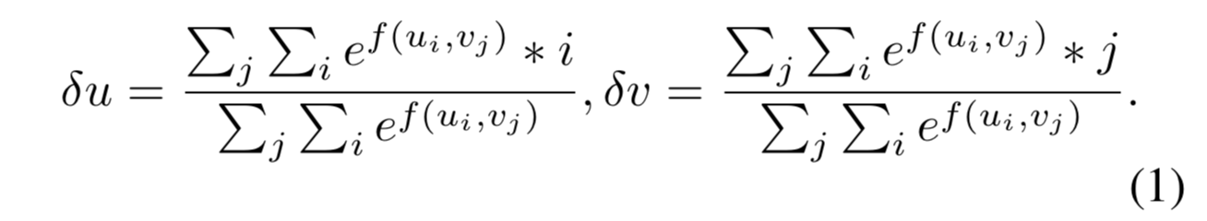
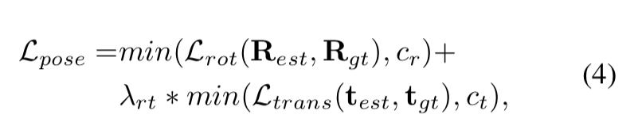
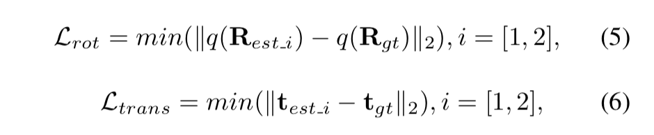
Method details and analysis
Soft-argmax detector head
5 x 5 patch for each keypoint
Weighted over u, v direction
Differentiable
Geometry-based loss
Correspondences → Fundamental matrix
Fundamental matrix → solve R, t
Optimize over the best R, t (min. error)

Slide 11
Experiment settings
Baselines
SIFT + RANSAC (Si-base)
SuperPoint + RANSAC (Sp-base)
SIFT + DeepF[34] (Si-models)
Our method – no end-to-end training (Sp-models)
Our method - with end-to-end training (DeepFEPE)
Datasets
KITTI
ApolloScape
[34] Rene ́ Ranftl and Vladlen Koltun. Deep Fundamental Ma- trix Estimation. In Vittorio Ferrari, Martial Hebert, Cristian Sminchisescu, and Yair Weiss, editors, Computer Vision – ECCV 2018, volume 11205, pages 292–309. Springer Inter- national Publishing, Cham, 2018.

Slide 12
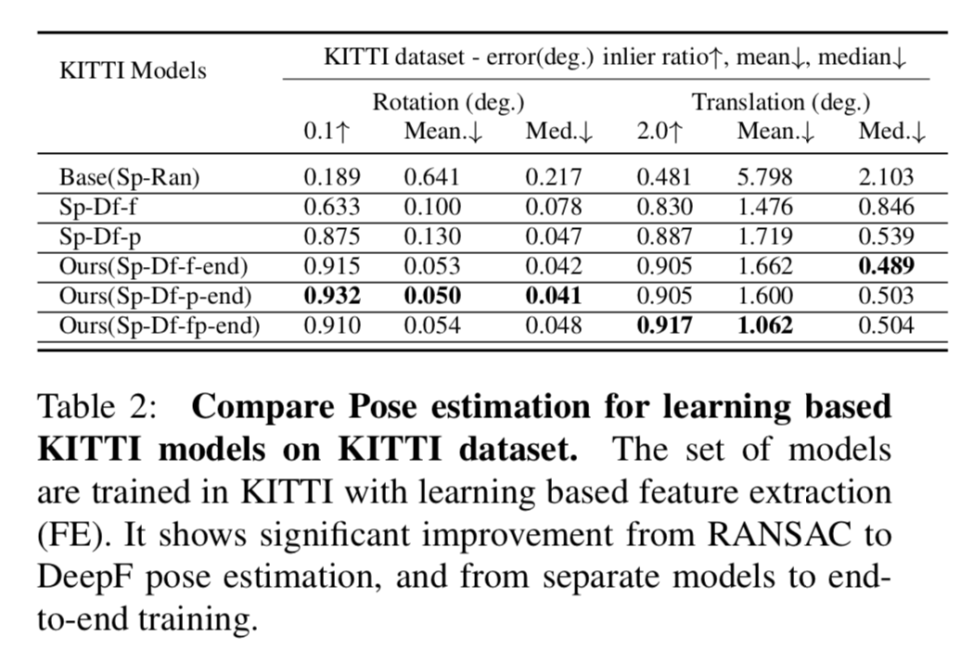
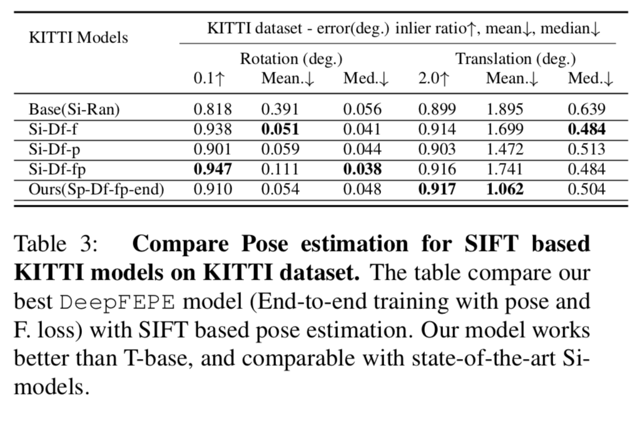
Experiment results
Models trained on KITTI, tested on KITTI

Slide 13
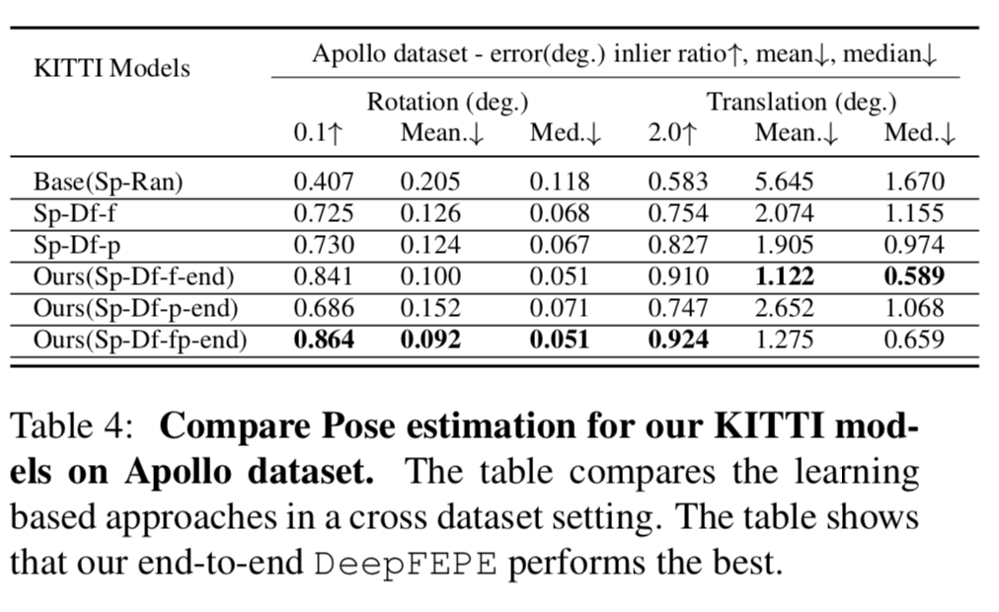
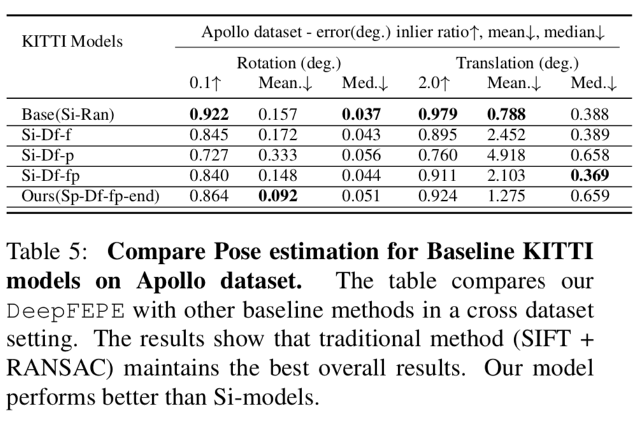
Experiment results – cross-dataset setting
Models trained on KITTI, tested on ApolloScape

Slide 14
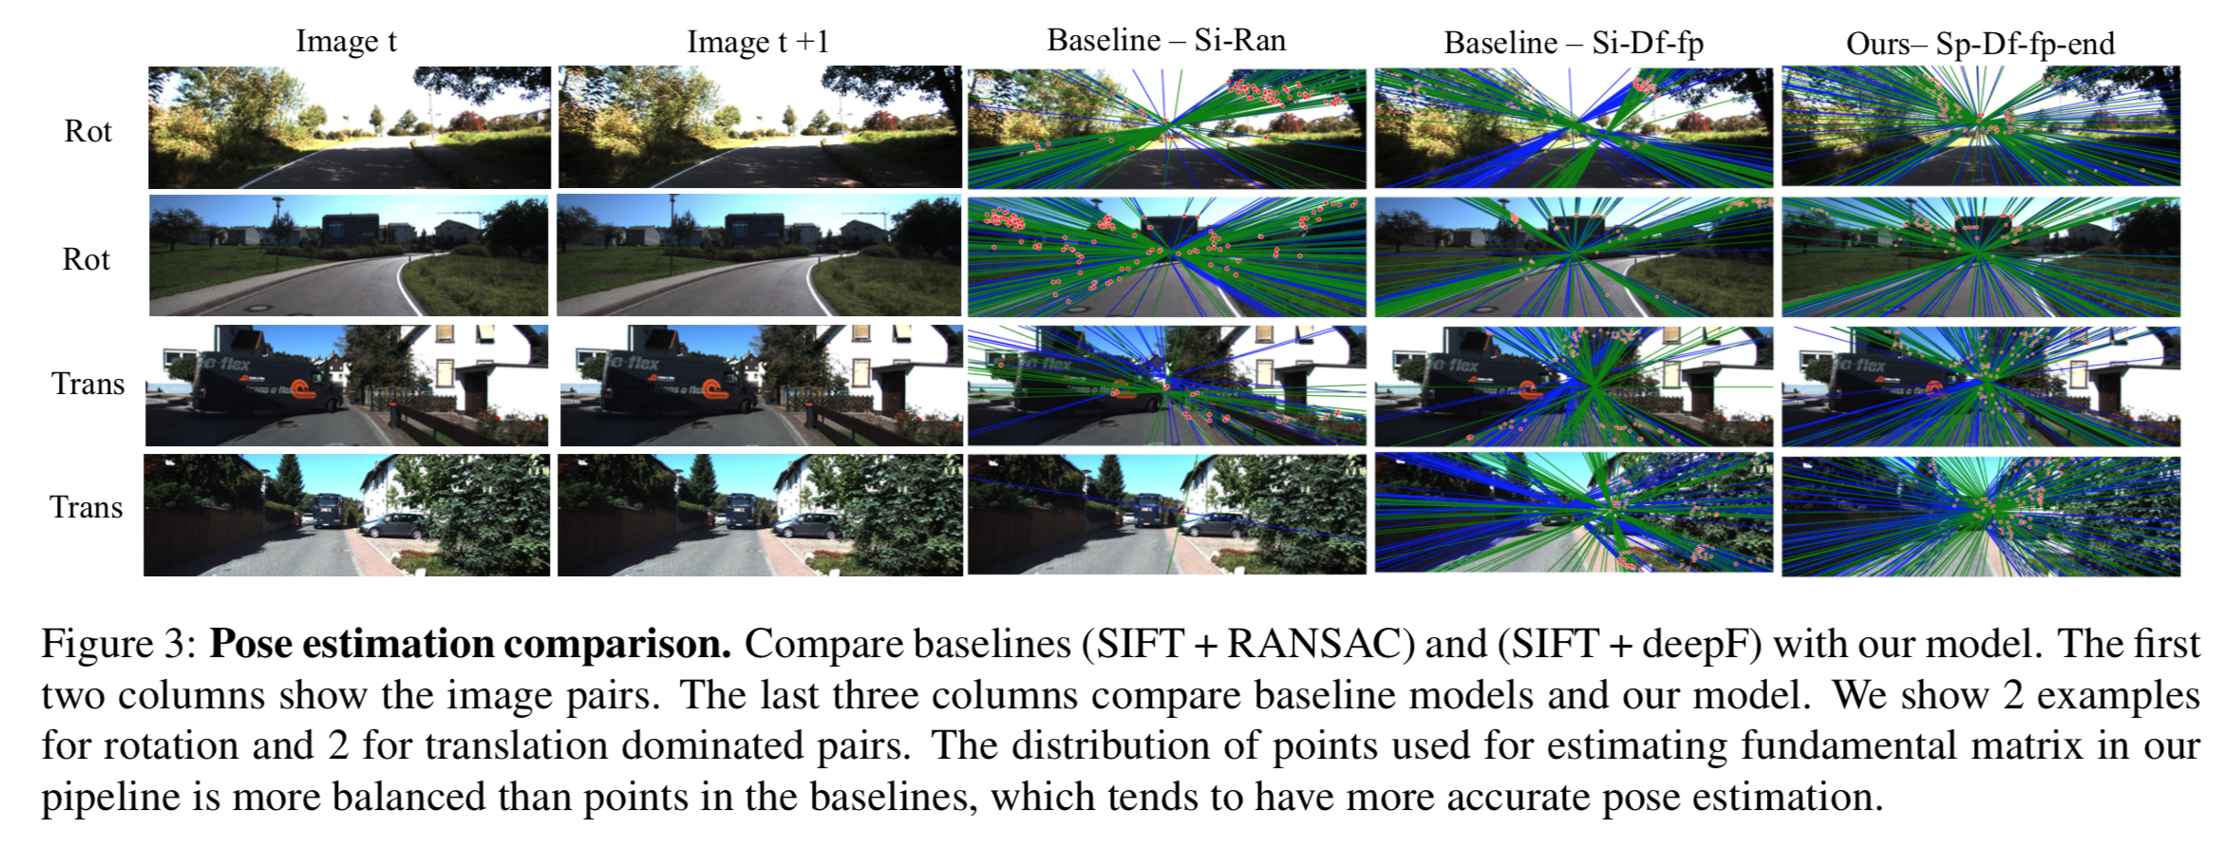
Qualitative results
Ground truth F.
Keypoints
Estimated F.

Slide 15
Conclusion and future work
From modules to end-to-end pipeline
Camera pose estimation to visual odometry
Cross-dataset evaluation could be done on indoor datasets

Slide 16
Outlines
Deep Keypoint-based Camera Pose Estimation with Geometric Constraints
Progress: Path to deep SLAM

Slide 17
Path to deep SLAM
A good SLAM system consists of …
Initialization, re-localization
Long feature tracking
Outlier rejection
Keyframe-based system
Robust bundle adjustment (BA)
Classic approach: ORB-SLAM

Slide 18
Path to deep SLAM
A good SLAM system consists of …
Initialization, re-localization
Long feature tracking
Outlier rejection
Keyframe-based system
Robust bundle adjustment (BA)
Classic approach: ORB-SLAM
What about deep learning pipeline?

Slide 19
How good are the deep SLAM methods
Classical methods
ORB-SLAM
Learning-based -- Supervised methods
DeepVO [1]
Learning-based -- Unsupervised methods
Depth-VO-Feat [2]
[2] Unsupervised learning of monocular depth estimation and visual odometry with deep feature reconstruction H Zhan, R Garg, C Saroj Weerasekera, K Li, H Agarwal… - Proceedings of the IEEE …, 2018

Slide 20
Cross-dataset generalizability
me | Link | Affiliation | Year | Platform | Publication | Environment
UZH-FPV Drone Racing | http://rpg.ifi.uzh.ch/uzh-fpv.html | UZH, ETH | 2019 | UAV | ICRA | Indoor, Outdoor
ADVIO Dataset | https://github.com/AaltoVision/ADVIO | Aalto U | 2018 | Hand | ECCV | Urban
KITTI | http://www.cvlibs.net/datasets/kitti/index.php | KIT | 2013 | Veh | IJRR | Urban
TUM-RGBD | https://vision.in.tum.de/data/datasets/rgbd-dataset | TUM | 2012 | Hand / Mob | IROS | Indoor
EuRoc | http://projects.asl.ethz.ch/datasets/doku.php?id=kmavvisualinertialdatasets | ETH-ASL | 2016 | UAV | IJRR | Indoor

Slide 21
Discussion and future works
Cross-dataset evaluation over different methods is in progress.
Generate thoughts for the deep SLAM pipeline.

Slide 22
References
[1] Deepvo: Towards end-to-end visual odometry with deep recurrent convolutional neural networks S Wang, R Clark, H Wen, N Trigoni - 2017 IEEE International Conference on Robotics …, 2017
[2] Unsupervised learning of monocular depth estimation and visual odometry with deep feature reconstruction H Zhan, R Garg, C Saroj Weerasekera, K Li, H Agarwal… - Proceedings of the IEEE …, 2018

Slide 23
Thank you

Slide 24
Backup

Slide 25
Motivation and problem description
Why visual odometry?
Localization
Mapping
Classic methods
ORB-SLAM: https://www.youtube.com/watch?v=IuBGKxgaxS0
Why deep learning?
Challenging scenes: textureless, lighting, indoor, outdoor
Hand-crafted → Optimize the system end-to-end
Notes:
However, they typ- ically perform poorly under extreme appearance changes, e.g., between day and night [71] or seasons [46], or in weakly textured scenes [59].

Slide 26
Brief summary of recent works
Pure deep learning visual odometry
Beyond tracking: LSTM, relative pose, absolute pose
Beyond tracking: Selecting memory and refining poses for deep visual odometry
F Xue, X Wang, S Li, Q Wang, J Wang, H Zha - … of the IEEE Conference on Computer …, 2019
DSVO: predict left frame from right frame
Deep virtual stereo odometry: Leveraging deep depth prediction for monocular direct sparse odometry
N Yang, R Wang, J Stuckler, D Cremers - … of the European Conference on Computer …, 2018
Not pure deep learning visual odometry
Self-Supervised 3D Keypoint Learning for Ego-motion Estimation
Visual Odometry Revisited: What Should Be Learnt?

